Slide 1
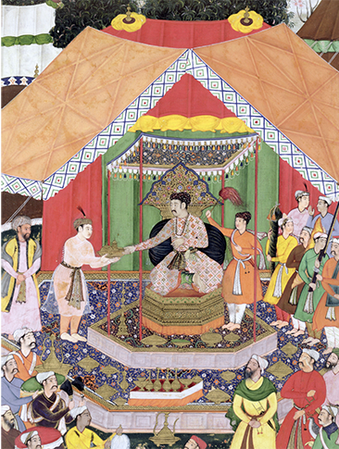
Civilizations of Asia (500-1650)
Lesson 1 The Delhi Sultanate and Mughal India

Slide 2
Civilizations of Asia (500-1650)
Topic 3 Lesson 1 The Delhi Sultanate and Mughal India
Learning Objectives
Describe the effects of the Delhi sultanate on India.
Explain how Muslim and Hindu civilizations interacted in India.
Describe the historical origins and central ideas of Sikhism.
Summarize the policies of Akbar that strengthened Mughal India.

Slide 3
The Delhi Sultanate
Struggles for Power
After the Gupta empire falls (550) India fragments into small kingdoms
Indian culture will still flourish
Muslims capture Indus Valley (711) but will not travel further
In 1000 Muslim Turks and Arabs push into India, pillage North India but will not settle there
Muslim Invaders Triumph
The late 1100’s the Sultan of Ghur will defeat armies and make Delhi his capital
This sultanate will last from 1206 to 1526 marking the start of Muslim rule in North India
They win b/c they have better troops and Hindu princes still fight each other and are not united
Many Indians will convert because the caste system is too rigid, they seek political or economic advantage, or Islam is easier for them

Slide 4
The Delhi Sultanate
Changes Under the Delhi Sultanate
Sultans introduce Muslim systems of government
Turks, Persians, Arabs come to serve as soldiers or officials
Trade between India and Muslim lands increase
During the Mongol raids (1200) scholars from Baghdad came to India bringing Persian and Greek learning
Northern India Fragments
Mongol armies (1398) come in plunder North India and smash Delhi
Over 100,000 Hindus die
Delhi will slowly recover but the sultans will no longer control a large empire
North India will fragment into rival Muslim and Hindu states

Slide 5
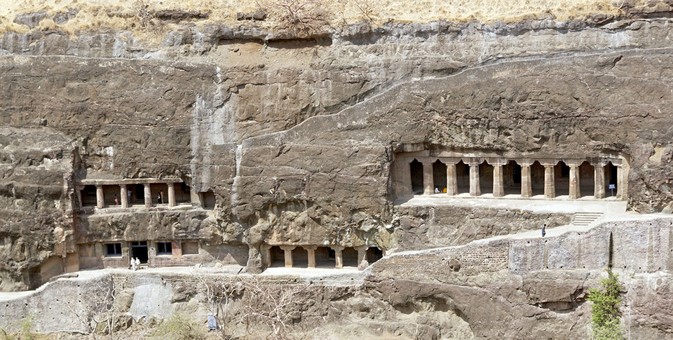
The Delhi Sultanate
This Buddhist rock-cut cave temple is in northern India. Buddhism was already an ancient religion by the time of the earliest Muslim invasions and an important part of Indian culture.

Slide 6
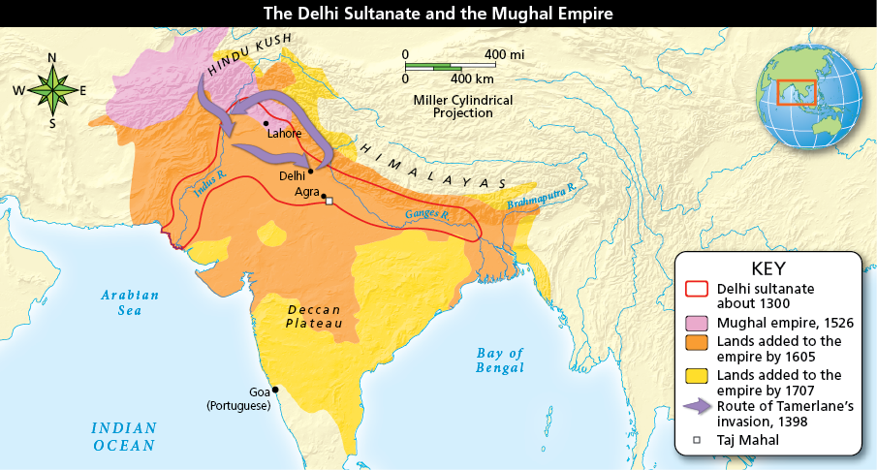
The Delhi Sultanate
Two Muslim dynasties ruled much of the Indian subcontinent. The Delhi sultanate lasted more than 300 years before the Mughal dynasty replaced it. Analyze Maps Describe Tamerlane’s route into India.

Slide 7
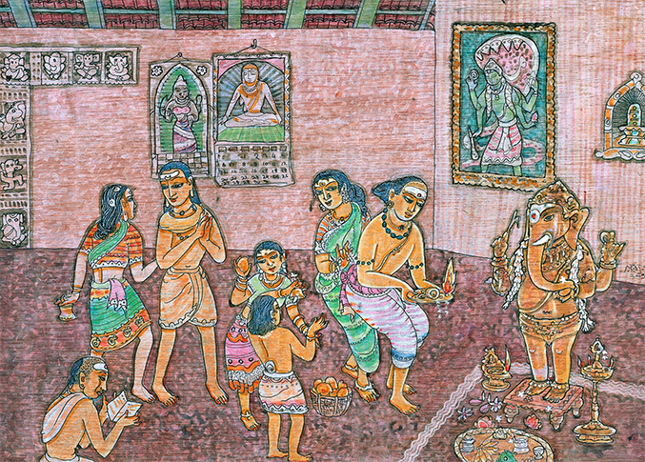
The Meeting of Islam and Hinduism
Hindu worshippers leave offerings at a home altar for the elephant-headed god Ganesh. Hindus call Ganesh the god of beginnings. He is also known as 'Lord of the People.'

Slide 8
The Meeting of Islam and Hinduism
Hindu-Muslim Differences
Hinduism- ancient religion, had many sacred texts, prayed to many statues, believed that statues represented different aspects of one God
Islam was a new religion, had one text, and believed in only one God, was offended that there were multiple idols
Hindus accepted the caste system and Brahmins as priests
Muslims believed in equality and no religious hierarchy
Tolerance Grows
Some Muslim scholars will argue that behind the multiple gods is one God
Hinduism will be accepted as a monotheistic faith
Hindus will be allowed to worship if they pay a tax
Some sultans will even let rajah stay ruling their area

Slide 9
The Meeting of Islam and Hinduism
Cultural Sharing
Indian converts to Islam are going to bring Hindu customs to marriage
Both groups will honor each other saints
In response to Islam Hindu conservatives strengthen caste rules
Muslims in India will be divided on the basis of the caste
A new language, Urdu, will begin. It combines Persian, Arabic, and the Indian language spoken in Delhi

Slide 10
Sikhism Emerges
A Message of Equality and Tolerance
Sikh means disciple
Belief in one God for all humanity, believe in the equality of all people in the eyes of God no matter what
This is a very radical concept in the 15 and 1600’s
They abolish the caste system, allow widows to remarry, and put women in positions of power in their society
Taking New Names
When Sikh 1st started a person’s last name indicated what caste they were in.
Gobing Singh, the 10th Sikh Guru, had men change their last names to Singh which meant lion and women to Kaur which means princess

Slide 11
Sikhism Emerges
The 'Five Ks‘
The 5 K’s are the 5 articles of faith that begin with the letter K
Kesh- uncut hair covered by a turban
Kirpan- religious sword representing the responsibility to fight oppression
Kera- a metal bracelet
Kanga- a comb
Kachera- special underclothing
They are worn to honor the Sikh Gurus and to publicly proclaim the wearer as a follower of Sikhism

Slide 12
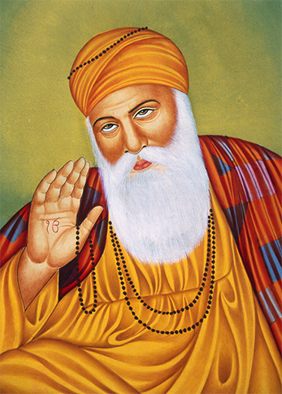
Sikhism Emerges
Portraits of Guru Nanak held places of honor in Sikh homes. This tradition continues today.

Slide 13
Mughal India
Babur Founds the Mughal Dynasty
Using cannons Babur is going to beat the large army of Sultan Ibrahim
Babur is going to set up the Mughar dynasty (1526-1857)and destroy the Delhi Sultanate
The empire will be from the Himalayas to the Deccan Plateau
Babur grandson Akbar the Great (1556-1605) will earn the title by creating a strong central government
Akbar the Great
Will gain support of Hindus by ending the tax to practice other religions and allowing anyone to apply for govt. jobs regardless of caste
He promotes religious harmony through tolerance
To improve govt. he used paid officials instead of hereditary office holders. He modernized the army, encouraged international trade, standardized weights and measures, and introduced land reforms

Slide 14
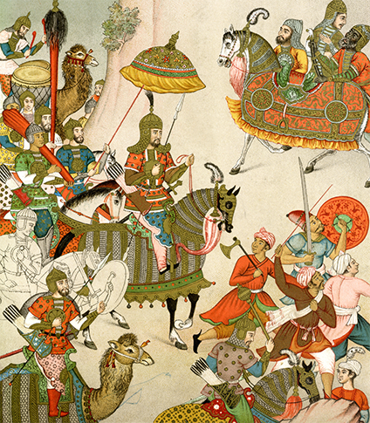
Mughal India
Babur assembles his army for his battle with Sultan Ibrahim to win control of Delhi.

Slide 15
Mughal India
Akbar’s Heirs
Jahangir, Akbar’s son, was a poor ruler but left his wife Nur Jahan run things. She was one of the most powerful woman in Indian history
The high point of the Mughal literature, art, and architecture came under the rule of Shah Jahan, Akbar’s grandson
Taj Mahal
Built to honor his favorite wife Shah Jahan has the Taj built as a tomb.
Was going to build a twin Taj for his tomb, Shah’s son Aurangzeb captures Shah and imprisons his father
Mughal Decline
In the late 1600s Emp. Aurangzeb is going to reject Akbar’s tolerant policies and lose the support of the Hindus
There will be economic hardship because of taxes and revolts, Europeans will gain footholds, and it will only rule around Delhi

Slide 16
Quiz: The Delhi Sultanate
How did the Delhi sultanate affect Hindu society?
A. It forced the Hindu rajas to convert to Islam in an effort to destroy the Hindu religion.
B. It united the warring Hindu princes against Muslim rule.
C. It introduced Turkish, Persian, and Arab social and artistic influences to the area.
D. It limited trade between India and Muslim lands.

Slide 17
Quiz: The Meeting of Islam and Hinduism
Over time, Muslims and Hindus resolved their initial conflict by
A. keeping to their own areas and maintaining their own traditions without interference.
B. passing laws that allowed religious freedom.
C. mutually influencing each other’s traditions and culture.
D. agreeing to work together to establish a blended government.

Slide 18
Quiz: Sikhism Emerges
The Sikh belief system was radical for the time it was founded because it taught
A. that there was one God.
B. that all people were equal in the eyes of God.
C. that Sikhism was the only path to enlightenment.
D. that Sikhs were special people and were set above others.

Slide 19
Quiz: Mughal India
What was one of the policies Akbar enacted that helped strengthen his empire?
A. He promoted diversity within his government and court.
B. He rewarded the most loyal of his followers with government positions.
C. He decentralized the government, allowing nobles to rule their areas as they saw fit.
D. He imposed high tariffs to make trade more profitable.

